Slide 1






Lecture 22:
React Features II
Course - Web Development - II
-By
Instructor Name
‹#›
welcome@krmangalam.edu.in
Sohna Road,Gurugram,Haryana 122103

Slide 2

| Table of Contents
One way binding
Component based (functional, class)
Default and named export
References.
The End.
‹#›

Slide 3
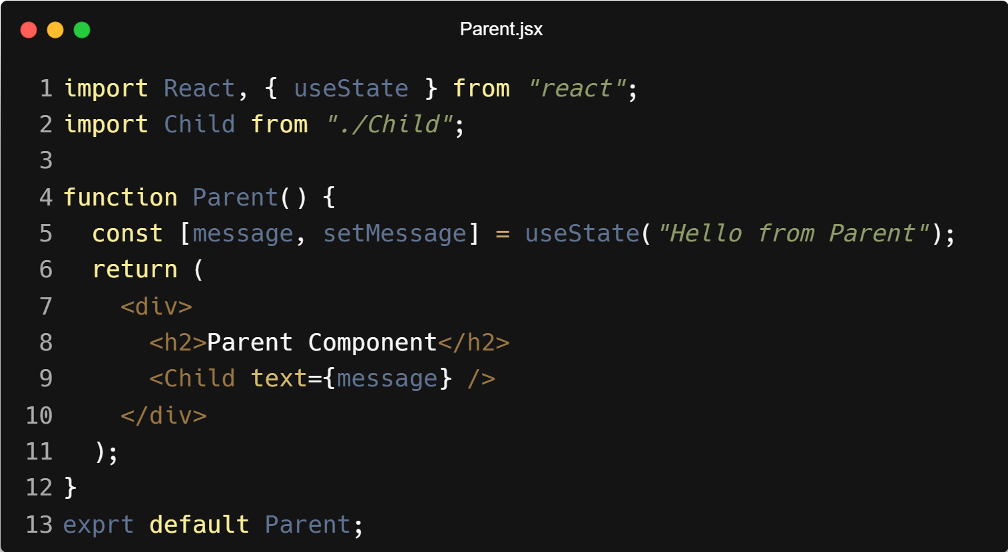
| One-Way Binding
One-way binding in React is a data flow pattern where state is managed in the parent component and passed down to child components through props, and the child cannot directly modify that data.
‹#›

Slide 4
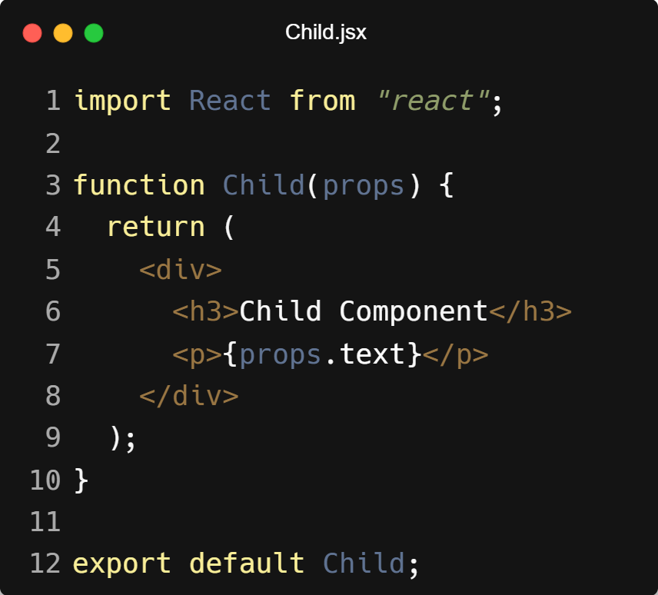
| One-Way Binding
‹#›

Slide 5
| Why One-Way Binding is Good in React?
Predictable Data Flow
Easier Debugging
Better Control
Better Performance
Scalable for Large Applications
‹#›

Slide 6
| React Components
React components are mainly divided into two formats:
Class Components
Functional Components.
‹#›

Slide 7
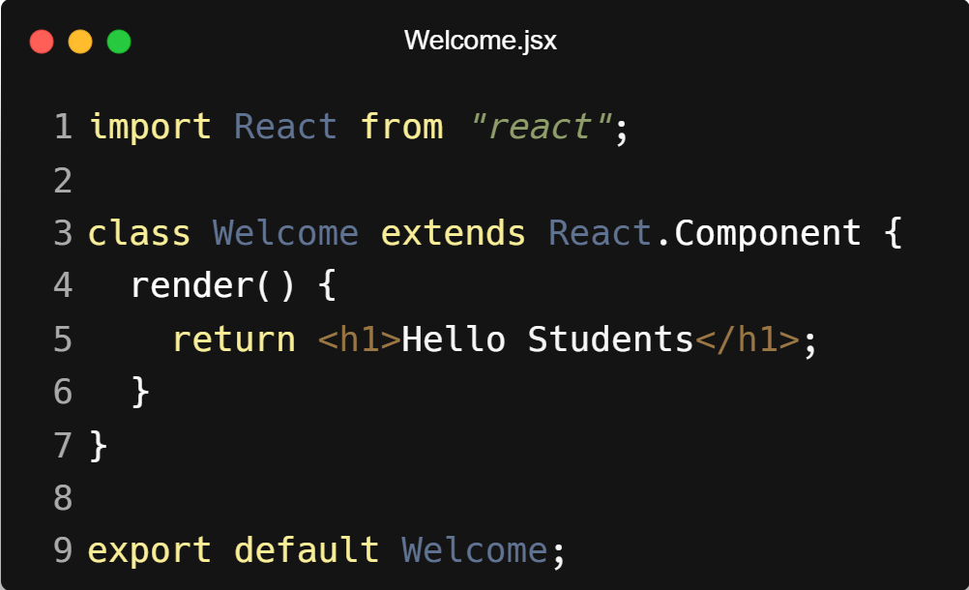
| Class Components
A Class Component in React is a component written using an ES6 class. It can store state, use lifecycle methods, and render UI.
A Class Component is a React component created using a JavaScript class that extends React.Component and must contain a render() method which returns JSX.
‹#›

Slide 8
| Class Components
Explanation
class Welcome extends React.Component → creates a React class component
render() → required method that returns JSX (UI)
React.Component → base class that provides React features like state and lifecycle methods
‹#›

Slide 9
| Key Features of Class Components
Uses this.state to store data
Uses this.setState() to update data
Supports lifecycle methods (componentDidMount, etc.)
Must include render()
‹#›

Slide 10
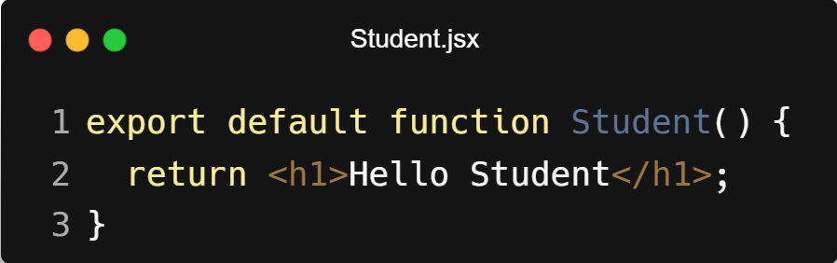
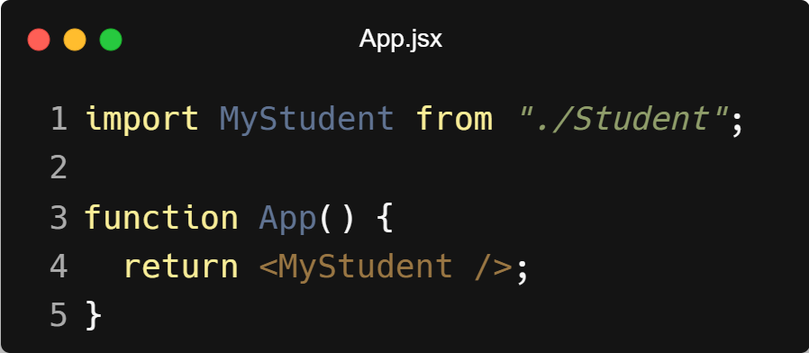
| Default Export
A default export means a file exports only one main thing.
You can import it with any name.
‹#›

Slide 11
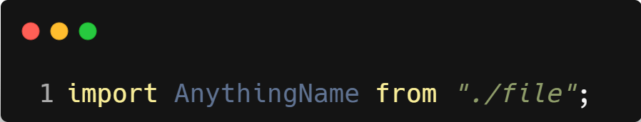
| Default Export
Notice:
File exported Student
But we imported as MyStudent
Name can be anything
Rule:
Only one default export per file
Imported without curly braces
‹#›

Slide 12
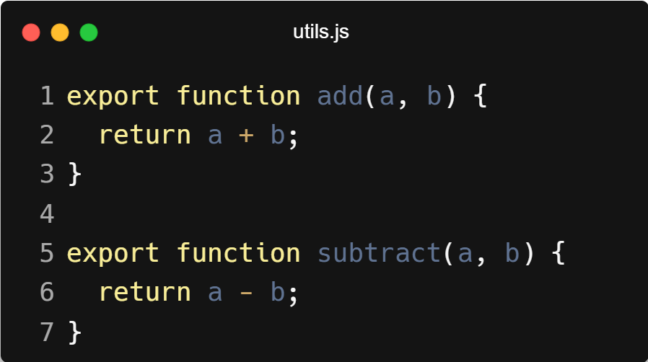
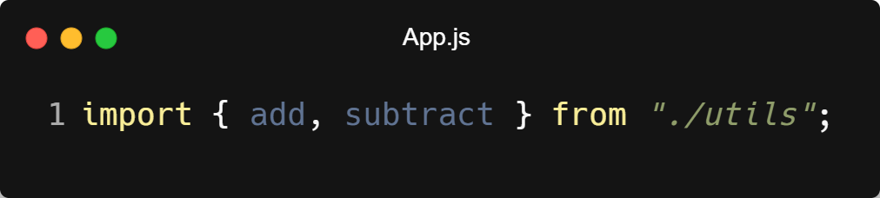
| Named Export
A named export allows you to export multiple things from one file.
Name must match while importing.
‹#›

Slide 13
| Named Export
Notice:
Must use curly braces {}
Names must match exactly
Rule:
You Can Export Multiple Things
Must Use Curly Braces While Importing
Import Name Must Match Exactly
You Can Rename While Importing (Using as)
‹#›

Slide 14
| Default vs Named Export
Feature | Default Export | Named Export
How many per file | Only 1 | Multiple allowed
Import syntax | No {} | Use {}
Name while importing | Can change | Must match
‹#›

Slide 15

| Check Your Understanding
Question : If you have useEffect(() => { ... }, [count]);, when will the effect's callback function be executed?
Options : a) Only once, when the component mounts.
b) After every single render of the component.
c) When the component mounts, and then again anytime the count state variable changes.
d) Only when the count state variable changes, but not on the initial mount.
Answer : c) When the component mounts, and then again anytime the count state variable
changes.
Explanation:
The dependency array tells React to re-run the effect if any of the values inside the array have changed between renders. It always runs on the initial mount as well.
‹#›

Slide 16
| References
MDN Web Docs : Comprehensive and official documentation for JS. 🔗https://developer.mozilla.org/en-US/docs/Web/JavaScript
W3Schools – JS Tutorial : Beginner-friendly JS tutorials with examples and interactive editors. 🔗 https://www.w3schools.com/js/
react.dev - A comprehensive, tutorial-style website that deeply explores core React concepts, including components, state, effects, and hooks, through interactive examples and in-depth explanations.
🔗https://react.dev/
‹#›

Slide 17
Thanks
For
Watching
Course - Web Development - II
‹#›
welcome@krmangalam.edu.in
Sohna Road,Gurugram,Haryana 122103

